Slide 1
Slow-pitch softball Camera: WEEKLY UPDATES
SDMAY25-11

Slide 2
This week’s Developments
Yolo screen
New Roboflow Data
Began integrating the YOLO screen to calculate height
Recorded and began annotating new image datasets for more accurate models

Slide 3
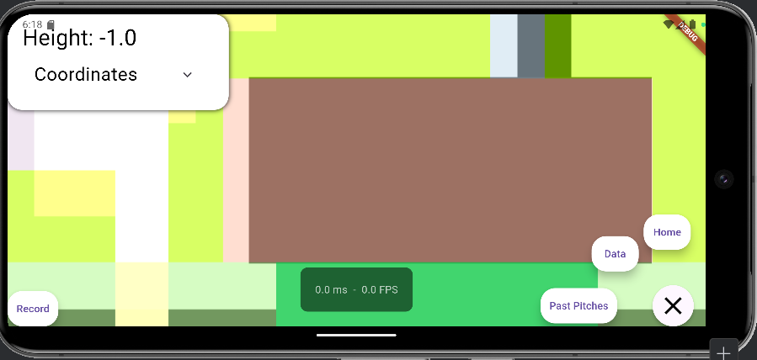
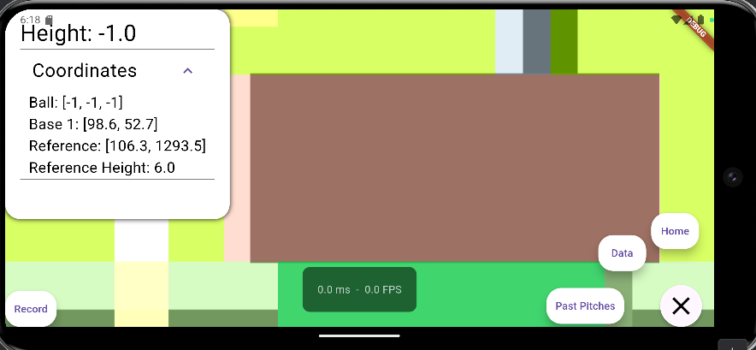
Integrating the YOLO screen
Added the navigational buttons and “Data” to the YOLO screen.
Cleaned up the data view on the screen
The recording for past pitches needs reworking since the Ultralytics plugin takes control of the camera
Android orientation and sizing issues

Slide 4
New roboflow training data
Collected videos with an optimal angle for the camera for a more accurate model
Current model does not track accurately from a distance
Currently in the process of annotating the dataset so we can start training the new model
App may require new models in the future for various lighting conditions

Slide 5
Next Week
Next week’s Plans
Work on the orientation and sizing issues of the YOLO screen for Android
Work on parsing the YOLO model’s predictions in Flutter
Continue annotating the Roboflow dataset.

